Slide 1
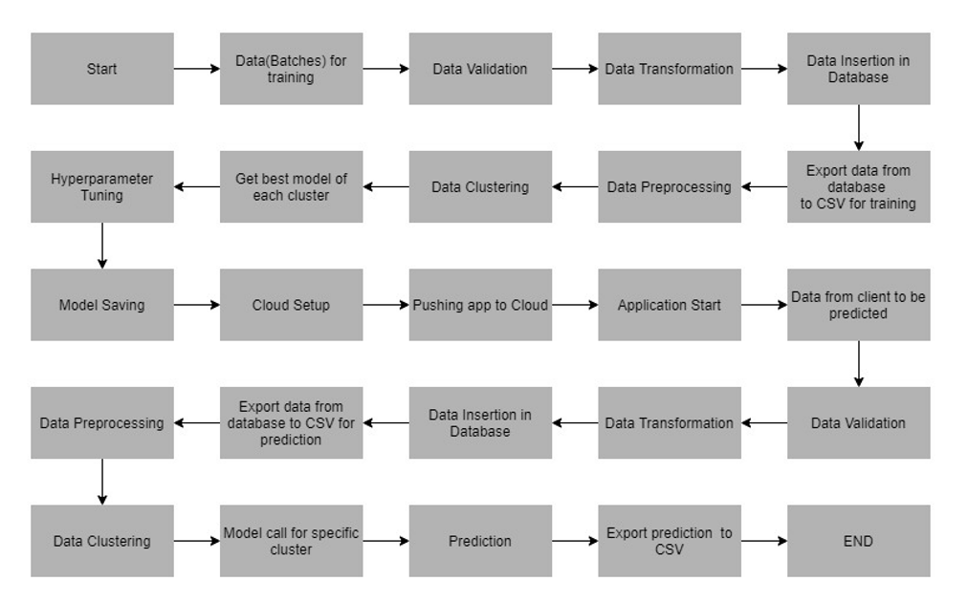
Architecture

Slide 2
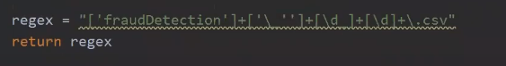
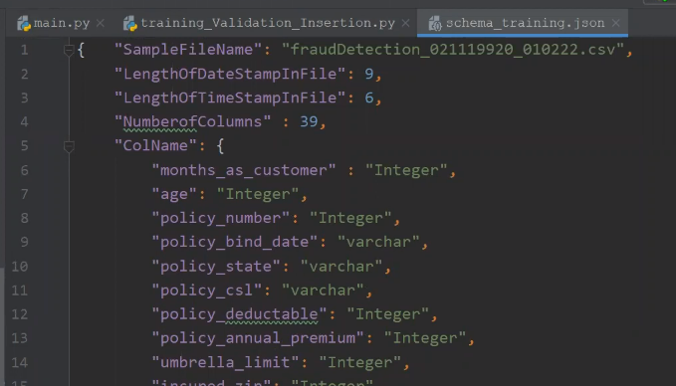
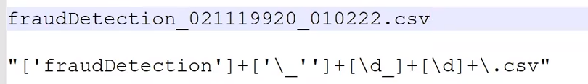
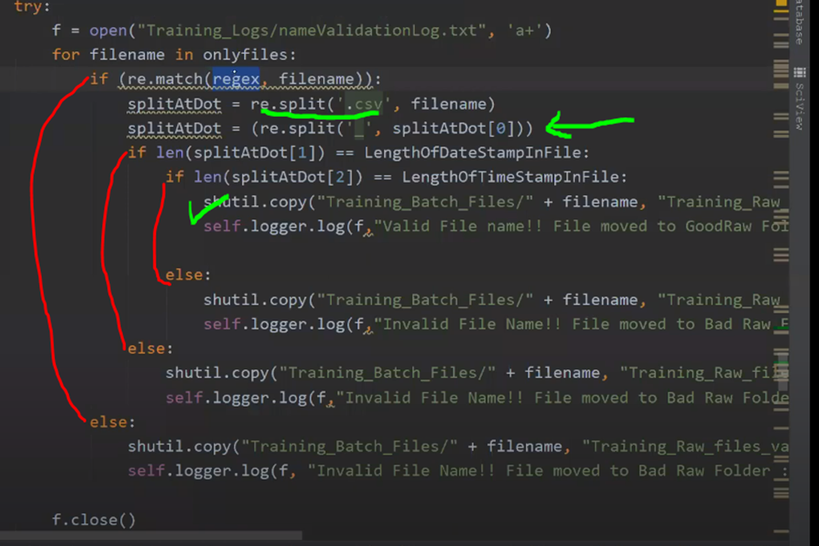
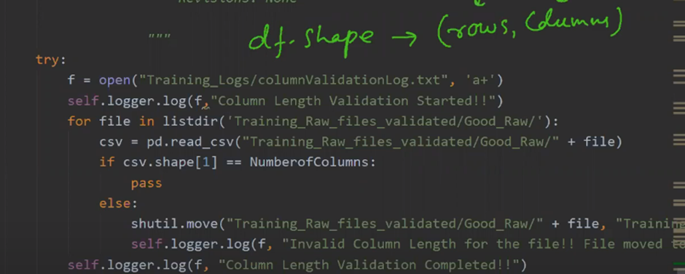
Data Validation
We check the following :
File name as per format
Length of Datestamp
Length of Timestamp
No of Columns
Drop Columns with all Null Values

Slide 3
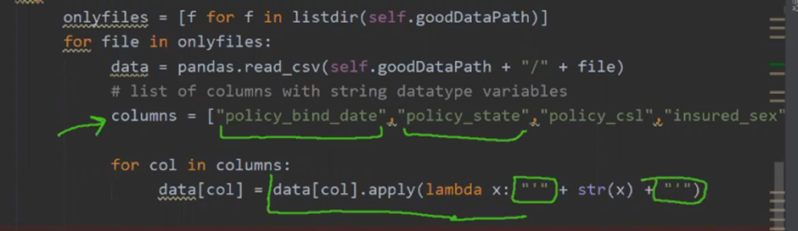
Data Transformation
We make the data suitable for the Database
1. Replace Nan or missing values with NULL ----- fillna(‘NULL’)
df.fillna(‘NULL’,inplace=True)
2. Strings in single quotes (python) convert to double quotes for DB because then DB will understand it as a varchar

Slide 4
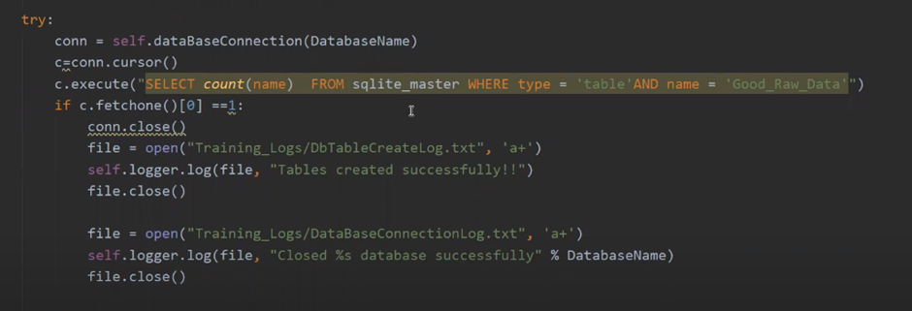
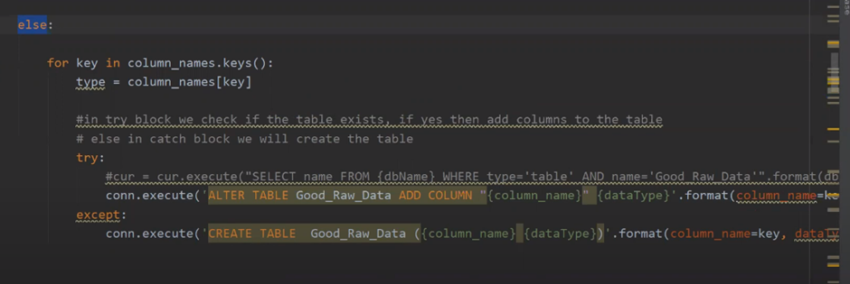
Data insertion in DB
All the valid files are kept in Good Data Folder.
We need to aggregate all these valid files and store the data in the Database.

Slide 5
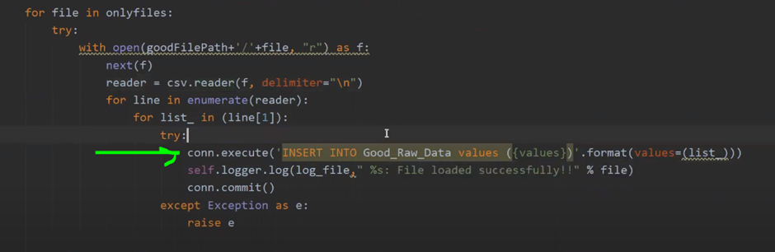
Data insertion in DB
INSERT VALUES IN THE TABLE

Slide 6
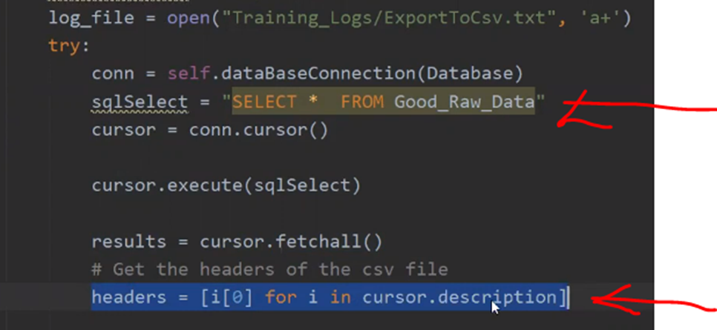
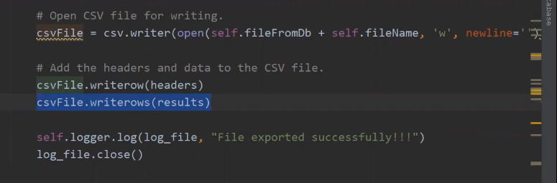
Export data from DB to csv

Slide 7
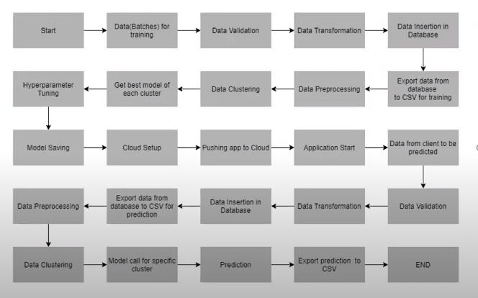
Architecture
Bad data Folder

Slide 8
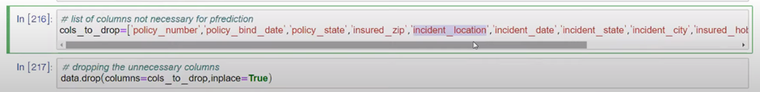
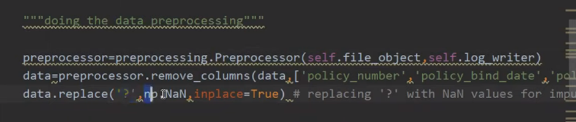
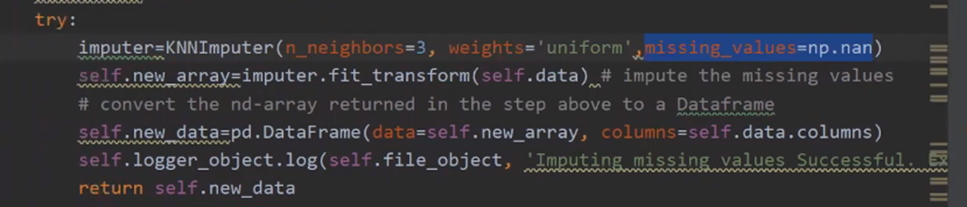
Data Preprocessing
Imputing Missing values

Slide 9
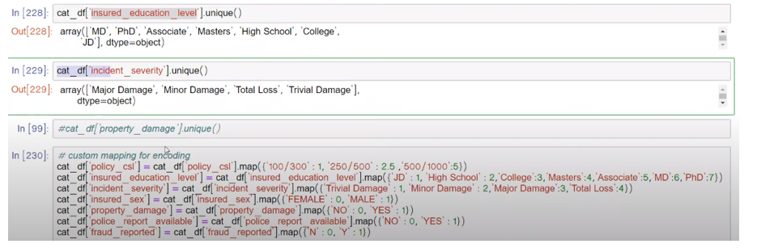
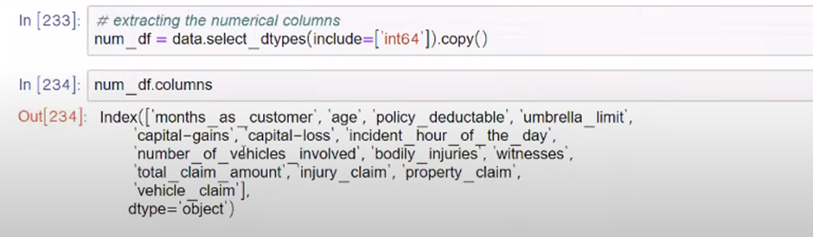
Data Preprocessing
Handling Categorical and Numerical features
Scaling Numerical features

Slide 10
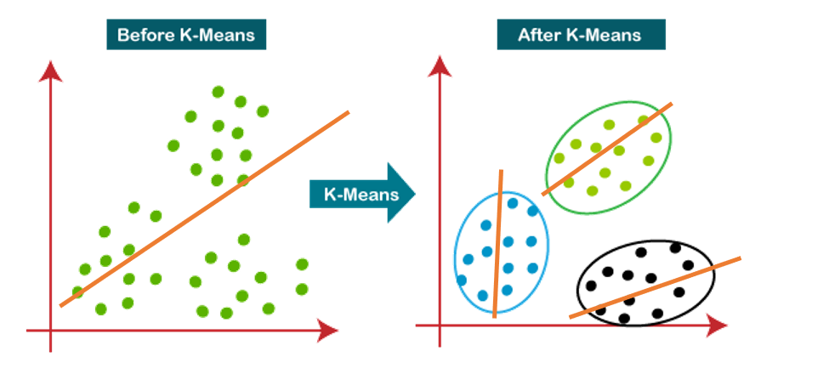
Data Clustering
Why Data Clustering ?
Error R
Error R1+R2+R3 < R

Slide 11
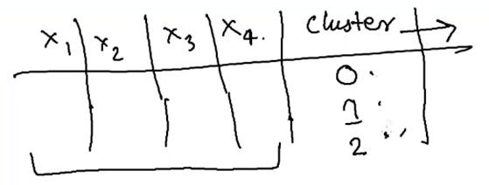
Data Clustering
We clustered all the training data into different clusters.
We used Kmeans clustering
To get the Optimum value of K we used Knee Locator function of Kneed library
Kn.knee gives the optimum value of K
Using this K we will use the Kmeans algorithm with initilaization parameter= Kmeans++
Will create another new column data[‘Cluster’]

Slide 12
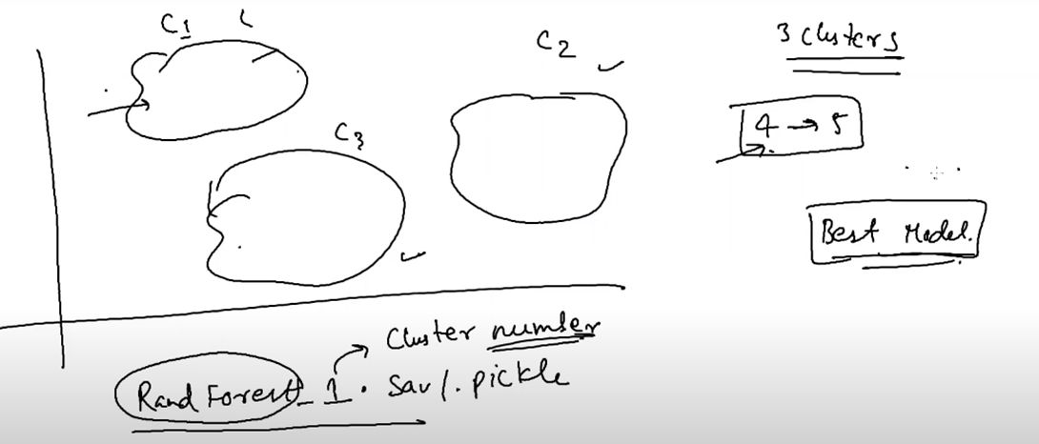
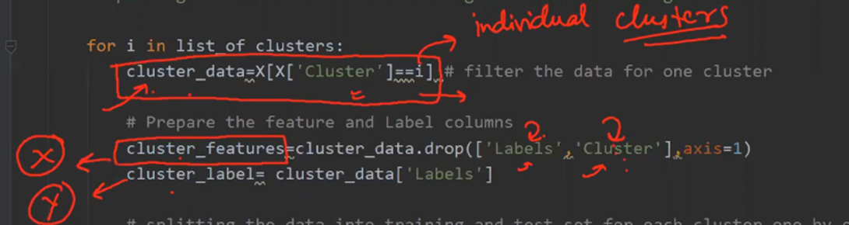
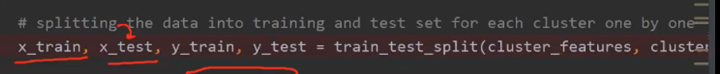
Data Clustering
We will now make groups based on cluster number
Get X and Y
Train Test Split
Create ML models for each group :

Slide 13
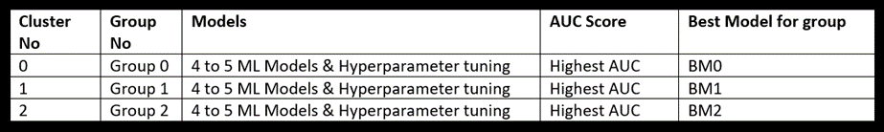
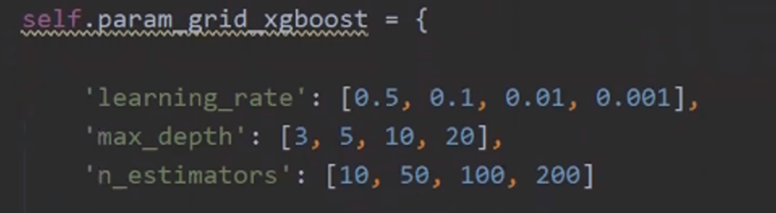
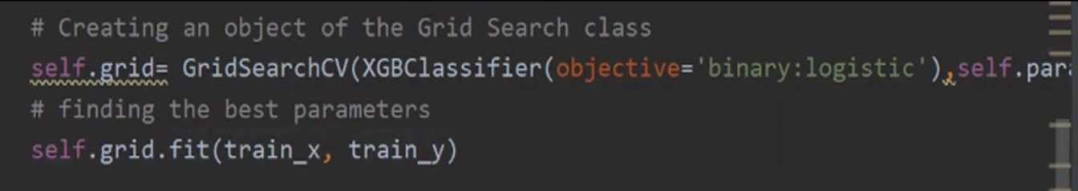
Models
Approach :
1. We train different models on each cluster
2. Perform Hyperparameter tuning & get the best_params_
3. Using the best_params_ again train the model

Slide 14
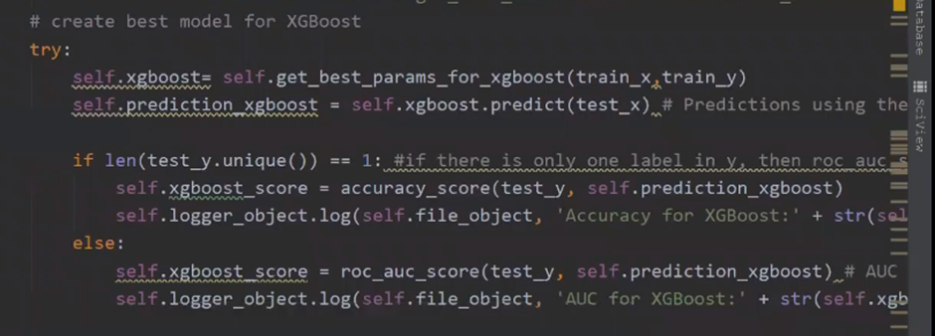
Models
Use best_params_() to get the best value of each parameter
Train Model again with these best parameters
Evaluate AUC score of each model using sklearn.metrics.roc_auc_score
Get the best model which has highest AUC score
This model will be saved to directory

Slide 15
Architecture
Bad data Folder

Slide 16
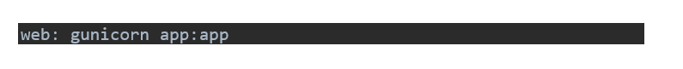
Cloud Setup
requirements.txt
Create Login credentials on Cloud Environment
manifest.yml
runtime.txt
Download the CLI of Cloud Env
Procfile
PUSH command from CLI
URL of the web app

Slide 17
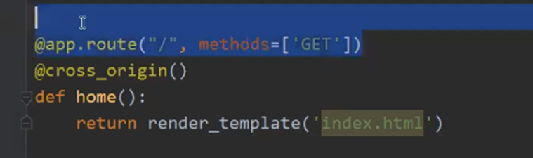
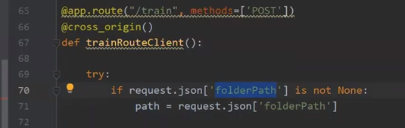
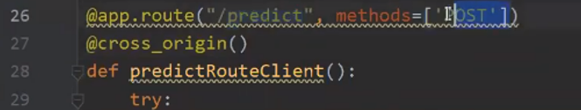
FLASK
EMPTY ROUTE
TRAINING ROUTE
PREDICT ROUTE

Slide 18

Prediction Pipeline

Slide 19
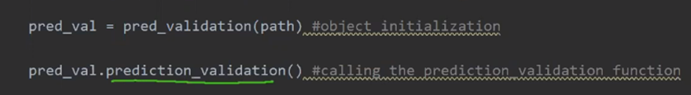
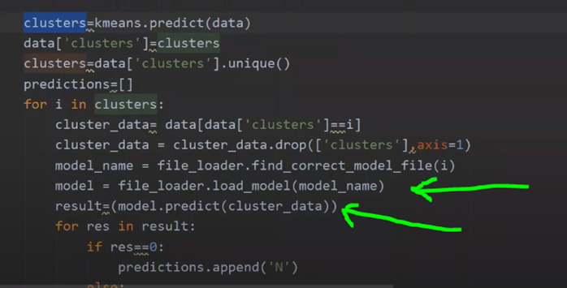
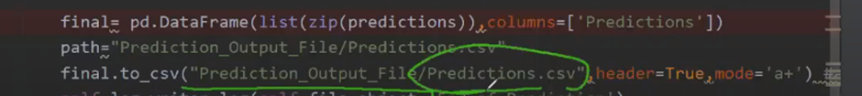
Prediction Pipeline

